Slide 1
Computer Architecture
Lab 9 Pipelining

Slide 2
Instruction Cycle
Instruction Fetch
Execution
Write Back
Instruction Decode
Memory
Control Unit
Arithmetic Logic Unit
Memory

Slide 3
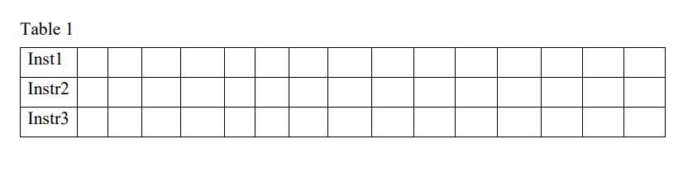
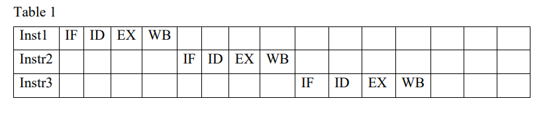
Non-Pipeline
20 ns
20 ns
20 ns
20 ns
t_{n}
Total execution time in a non-pipelined: n x t_{n} = 3 x 20 x 4 = 240 ns
Num of Instructions or tasks
Num of stages
Time for each stage
t_{n} is the time to complete each task on a non-pipeline unit
t_{n}

Slide 4
Non-Pipeline
Memory
Control Unit
Arithmetic Unit
Memory

Slide 5
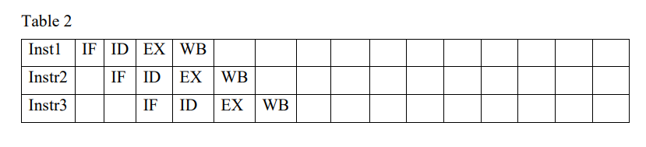
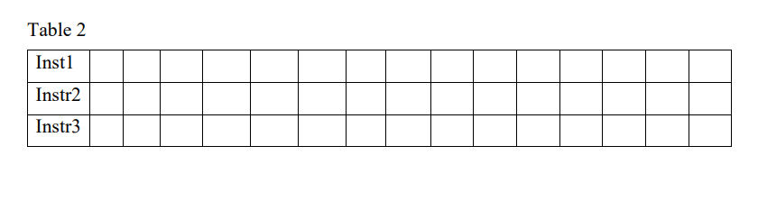
Pipeline
t_{p} = 20 ns
Total execution time in a pipelined machine = (k + n-1) x t_{p} = (4+3-1) x20 = 120 ns
Num of stages
Num of instructions or tasks
t_{p} is the time period to complete a k-stage pipeline.

Slide 6
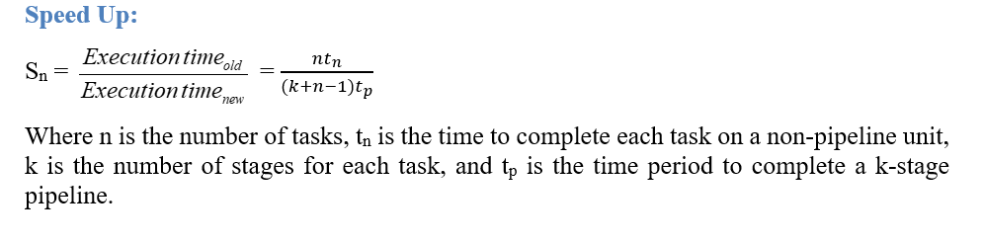

Slide 7
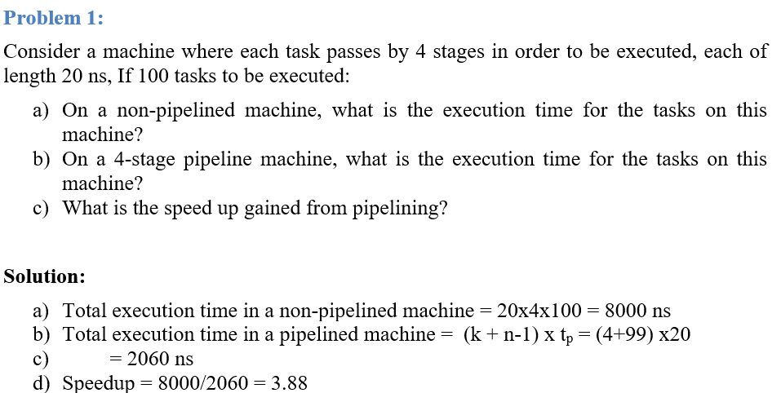

Slide 8
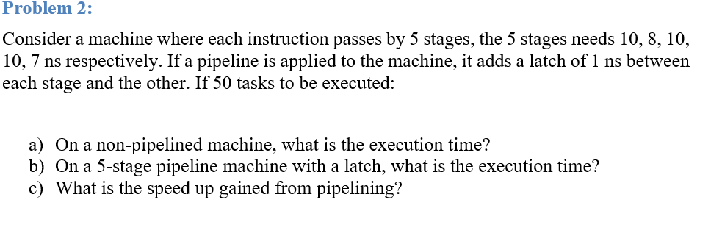
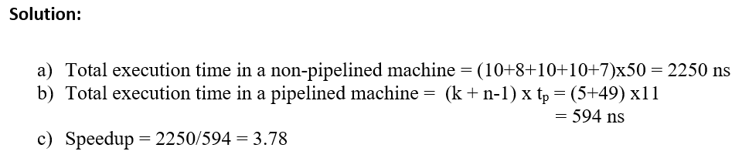

Slide 9
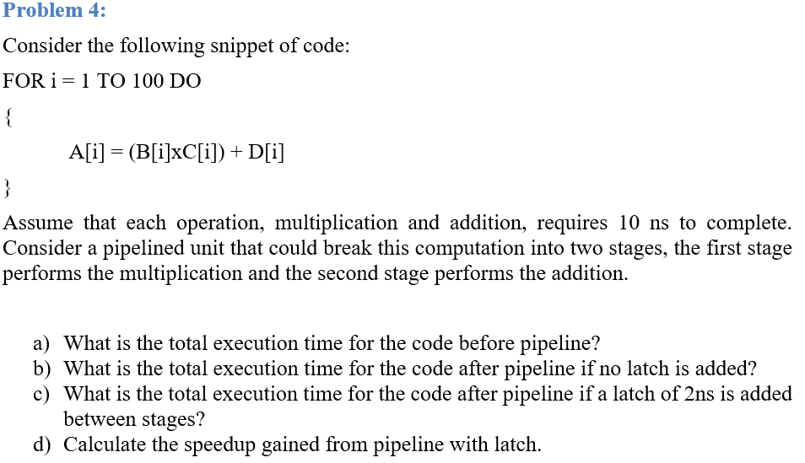
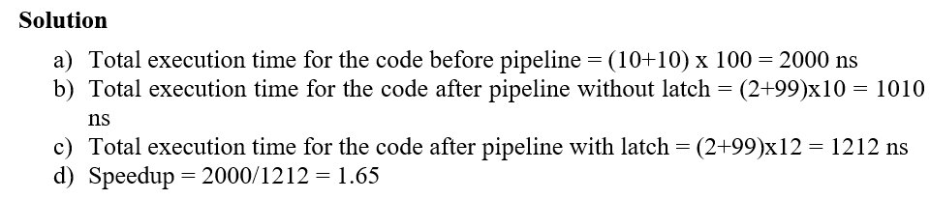

Slide 10
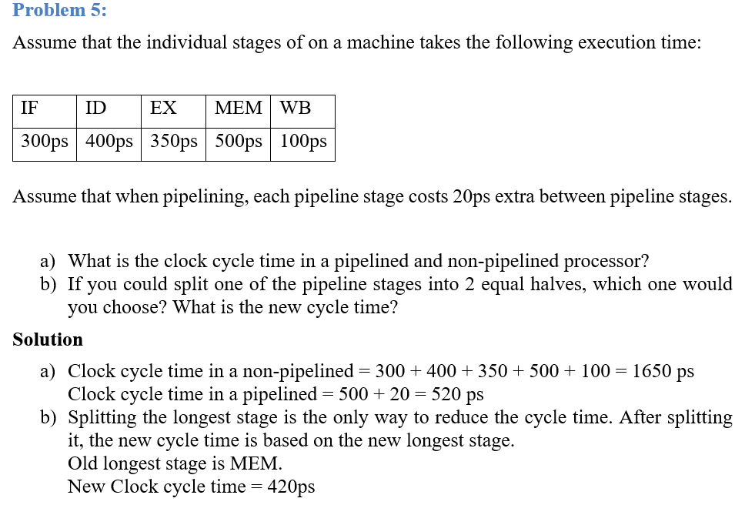

Slide 11
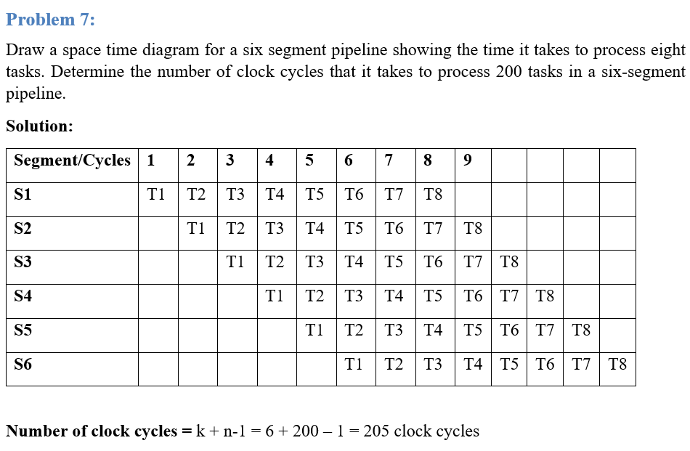

Slide 12
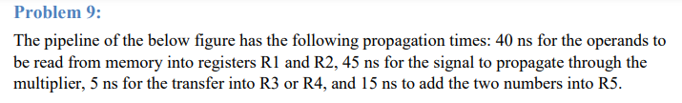
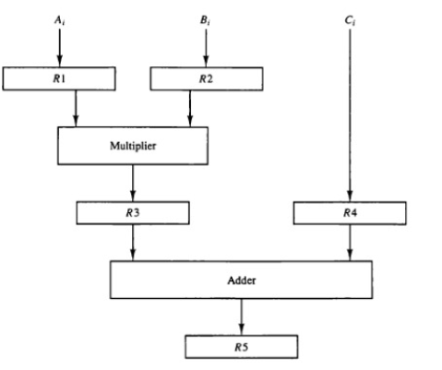

Slide 13
40 ns
45 ns
5 ns
15 ns

Slide 14
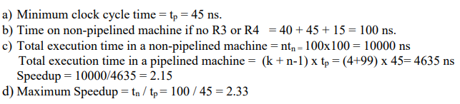
40 ns
45 ns
5 ns
15 ns

